Slide 1
Hormone receptors
Year 11 Biology
Bremer SHS

Slide 2
Warm-up questions
Describe the role of an enzyme.
List three factors that affect enzyme activity.
Define the term enzyme denaturation. Draw a diagram to assist with your response.
Name three hormones and describe their role.
Outline the role of the nervous system.

Slide 3
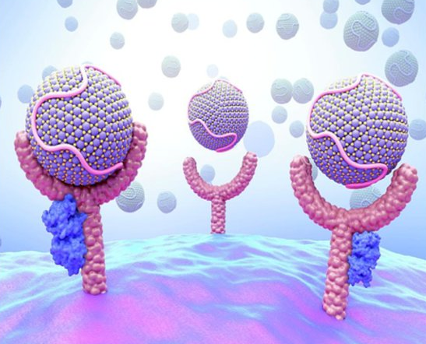
recap
Cells have many receptors present in their cell membranes.
The types of receptors present is dependent on the function of the cell.
Only cells in the body that have receptors for a particular hormone will respond to it.
If the cell does not have a receptor for the hormone, it will drift past the cell without any effect.

Slide 4
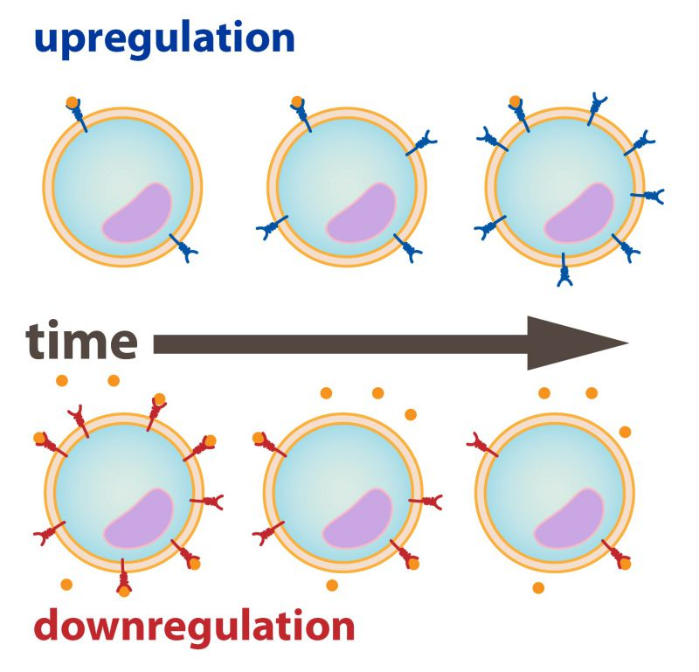
Upregulation and downregulation
A cell’s sensitivity to a hormone is determined by the number of receptors that it expresses. More receptors make it more responsive and less receptors make it less responsive.
Most cells only permanently express a small number of each type of receptor.
Upregulation occurs when a cell detects a hormone. It quickly produces more receptors to become more sensitive.
Therefore a hormone actually activates two pathways when it binds to receptor, the pathway it is signalling for and the pathway that triggers the production of its own receptors.
Downregulation occurs when a cell is prompted to produce less of a particular receptor. This usually occurs to restore homeostasis after a response to the hormone has been achieved.

Slide 5
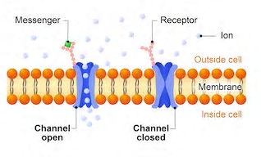
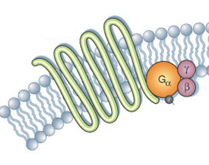
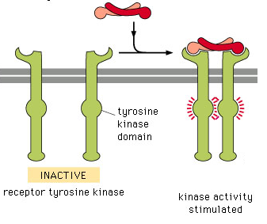
Types of receptors
Ion Channel Receptors
Binding hormone results in a channel opening that transports ions across a cell membrane.
G Protein-Coupled Receptors
Receptors have a protein called a G protein attached to them on the inside of the cell membrane.
G Protein is released when a hormone binds and activates other proteins inside a cell.
Tyrosine Kinase Receptors
These receptors or inactivated enzymes embedded in a cell membrane.
Binding a hormone activates the enzyme by changing their conformation.
Receptor

Slide 6
Response to receptor binding
When a hormone binds to its receptor protein, the receptor changes shape and becomes activated.
The activated receptor alters to activity of intracellular proteins, transmitting the message through the use of second messengers.
This process is called signal transduction.
Binding just one hormone can have a large effect on the cell because second messengers amplify signal transduction by activating many molecules in the cell.
Signal transduction can occur when hydrophobic hormones bind to intracellular receptors or when hydrophilic hormones bind to extracellular receptors.
HORMONE BINDS WITH RECEPTOR
Signal transduction through second messengers that target many different effector proteins.
Response from protein responsible for protein production.
Response from enzymes controlling cellular metabolism.
Response from proteins controlling shape of cell.

Slide 7
Check for understanding
Copy the following questions and answer them while you watch the following video.
https://www.youtube.com/watch?v=eWHH9je2zG4
Endocrine System, Part 1 - Glands & Hormones by Crash Course
Compare the endocrine and nervous system.
Define the term target cell.
Explain why hydrophilic (water soluble) hormones have receptors on the outside of the cell.
Explain why hydrophobic hormones have receptors on the inside of the cell.
Define the term hormonal cascade.

Slide 8
Check for understanding
Synthetic hormones are man-made hormones that are very similar to the hormones produced by the human body. These are then used as treatment for men and women whose own hormones are low or out of balance.
1. Research the following synthetic hormones.
2. Outline the risks associated with using synthetic hormones.
3. In your opinion, is it safe for a doctor to prescribe synthetic hormones?
SYNTHETIC HORMONE | NATURAL HORMONE IT REPLACES | ROLE OF HORMONE | REASON WHY SYNTHETIC HORMONE IS PRESCRIBED
Progestin
Estradiol
Levothyroxine
Epinephrine

